Slide 1

Tutorial: Linking, Extending, Exploiting and Enhancing Tabular Data with Wikidata ^{Part 4: Applications}
Daniel Garijo, Pedro Szekely
Information Sciences Institute and Department of Computer Science
@dgarijov, @szeke {dgarijo, pszekely}@isi.edu

Slide 2
Wikidata Applications

Slide 3
Wikidata Tools: Overview
Edit data
Help editing content, quality assurance, finding duplicates
Query data
Completeness, natural language support, linked items
Improve user interface
Hovering, enhanced search, summaries, keywords
Visualize data
Maps, graph charts, etc. from queries
Working with the schema
Find properties, classes
Lexicographic
Lexeme forms and building, term sensing
Tools for programmers
Manipulate Wikidata answers in JSON
Find all tools at: https://www.wikidata.org/wiki/Wikidata:Tools (Some are Wikibase gadgets)

Slide 4
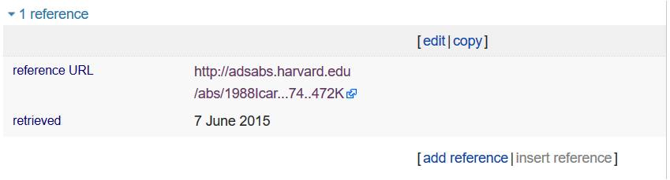
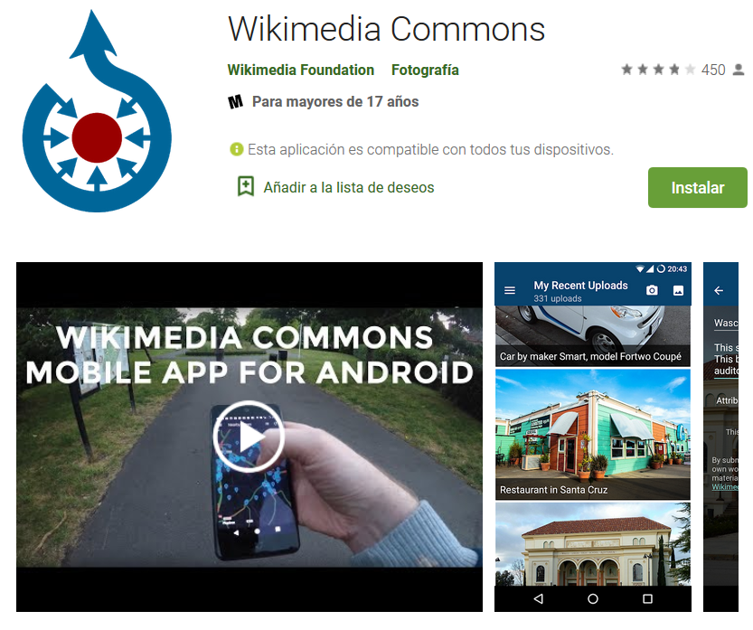
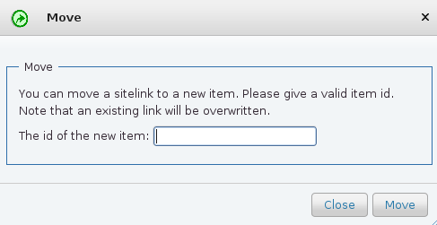
Wikidata Tools: Edit (Highlights)
Duplicate references from an entry
Find nearby elements with no photo and upload one
Move and redirect items

Slide 5

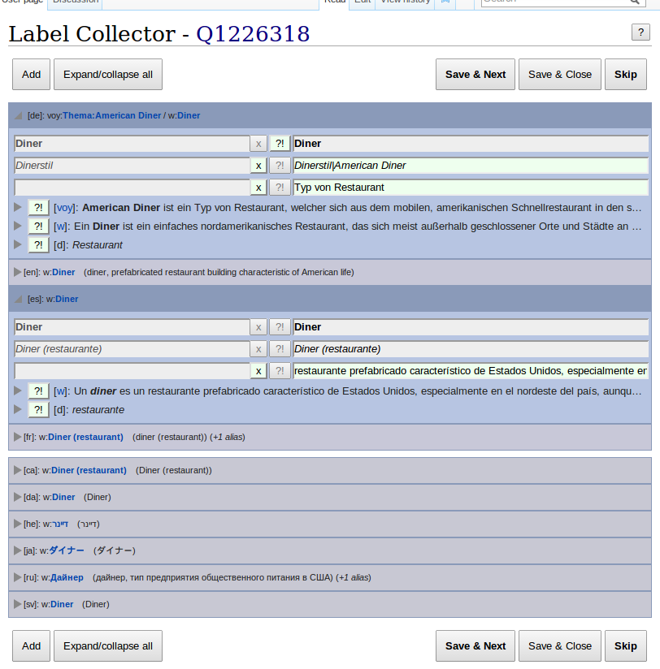
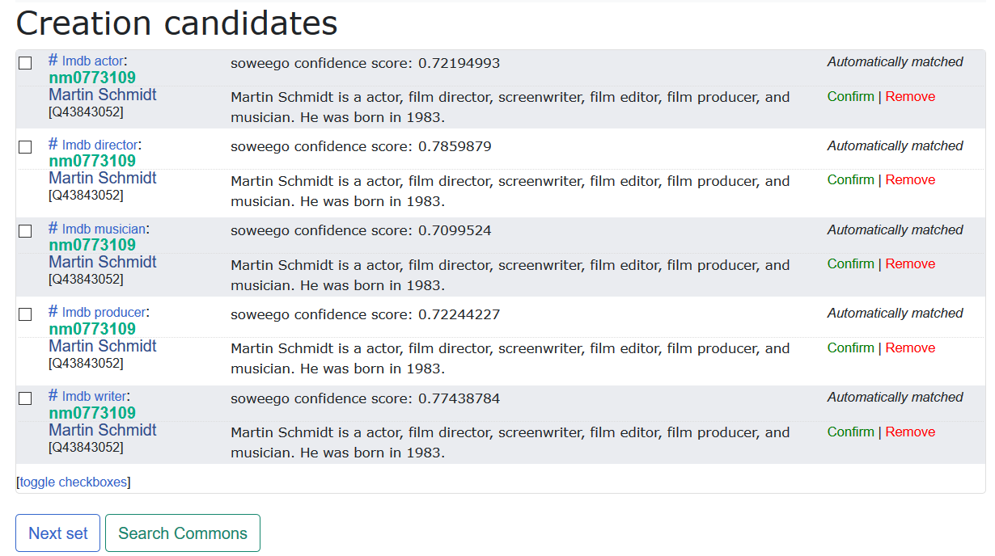
Wikidata Tools: Edit (Highlights)
Import records from other KGs to Wikidata
Help editing (dragging and dropping terms into other terms)
Help confirm entity mappings
Listing labels in other languages

Slide 6
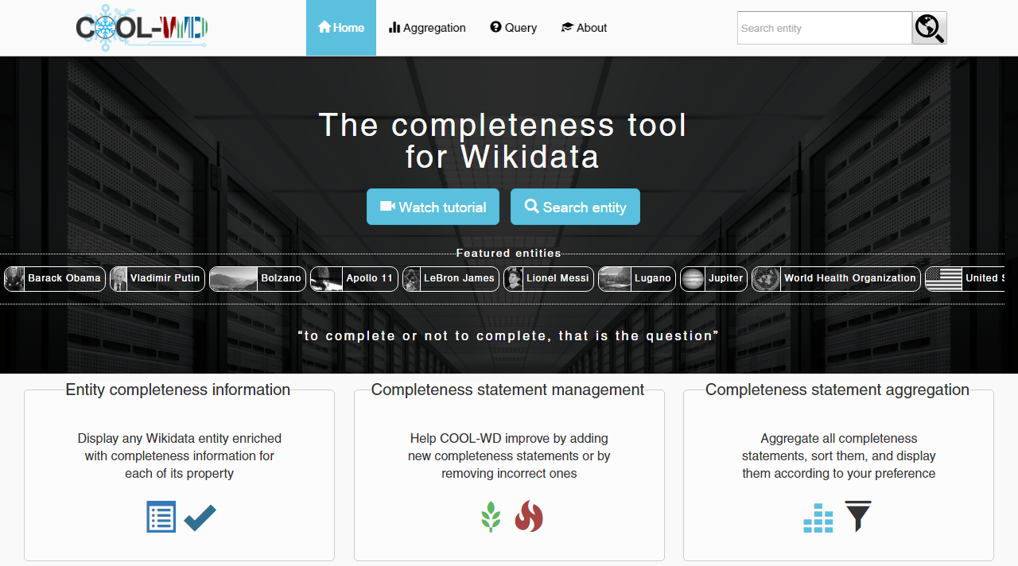
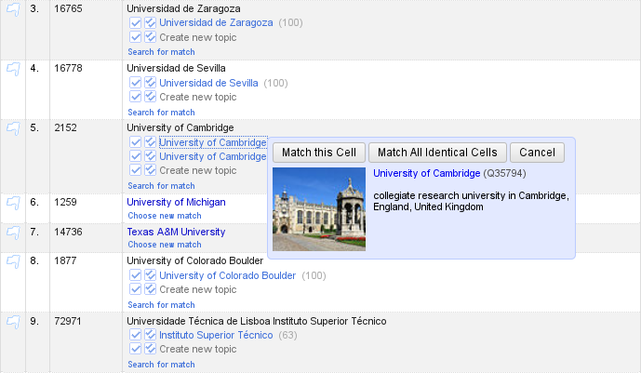
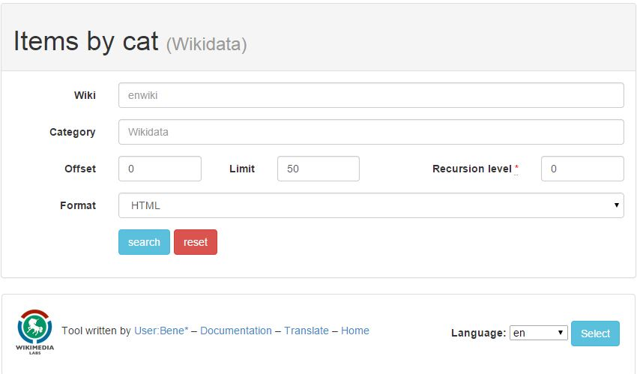
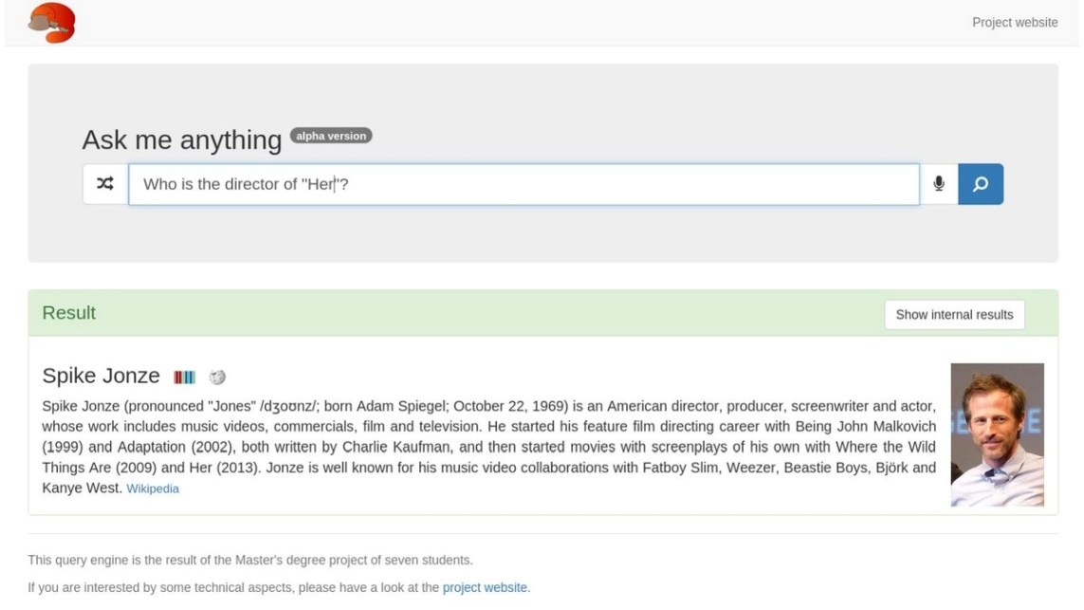
Wikidata Tools: Query (Highlights)
Assess completeness of records (COOL-WD)
Link and map statements (Open Refine)
List items by category
Platypus (natural language queries)

Slide 7
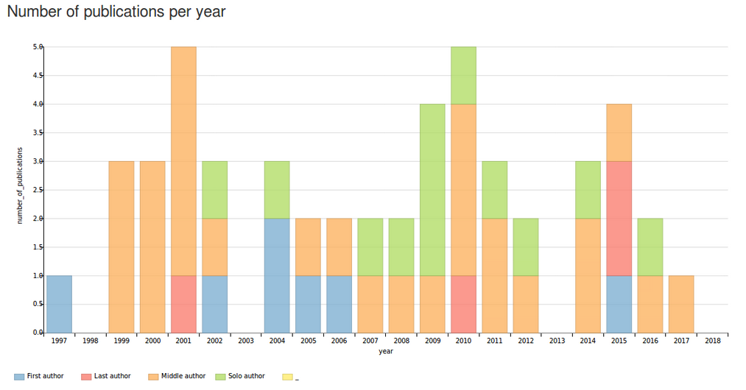
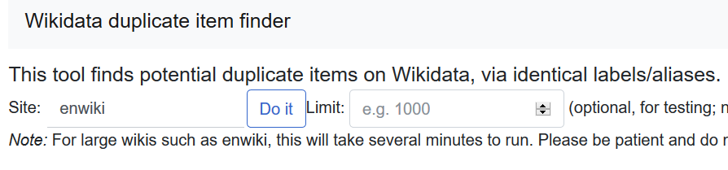
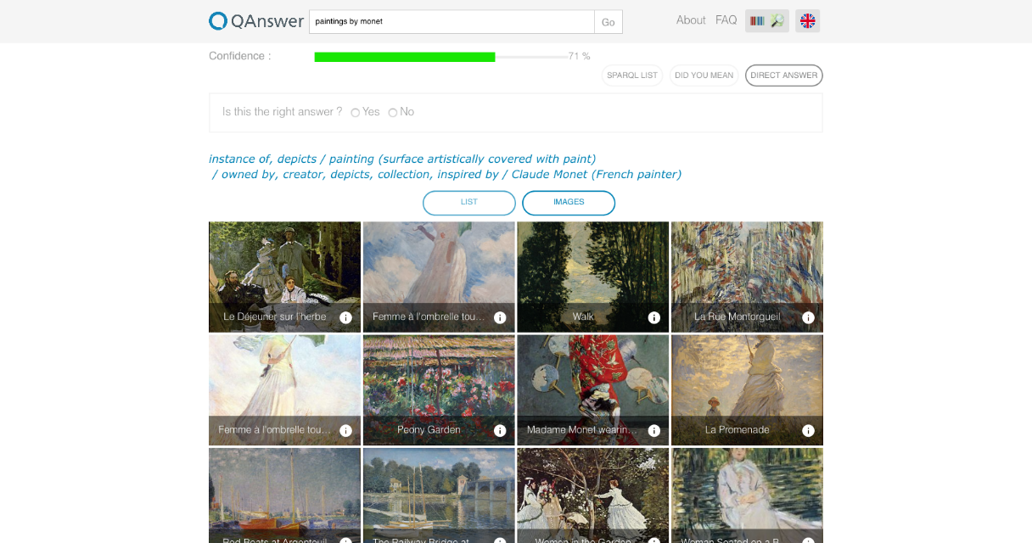
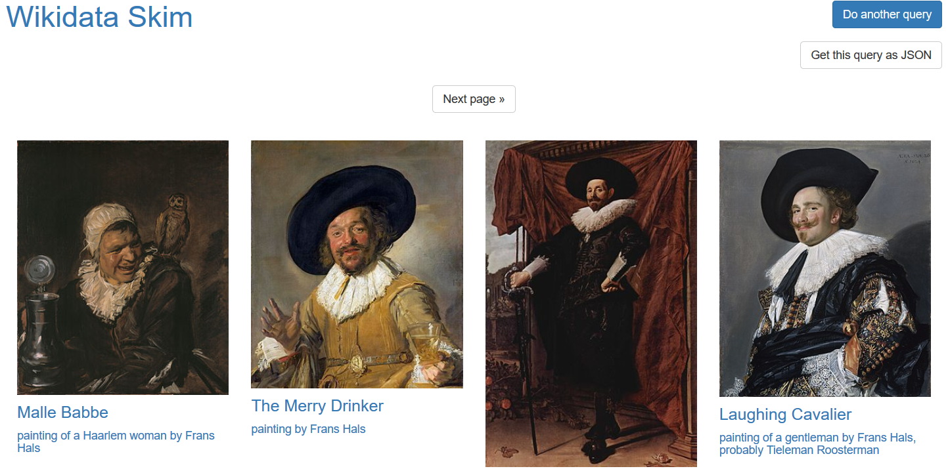
Wikidata Tools: Query (Highlights)
Scholia browser (used in Zenodo)
Find duplicates
Facilitate retrieving results Wikidata Skim (lightweight answers),
QAnswer

Slide 8
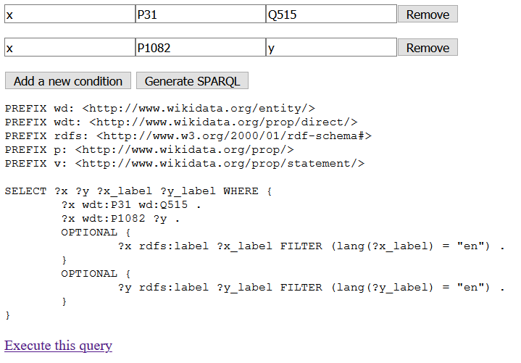
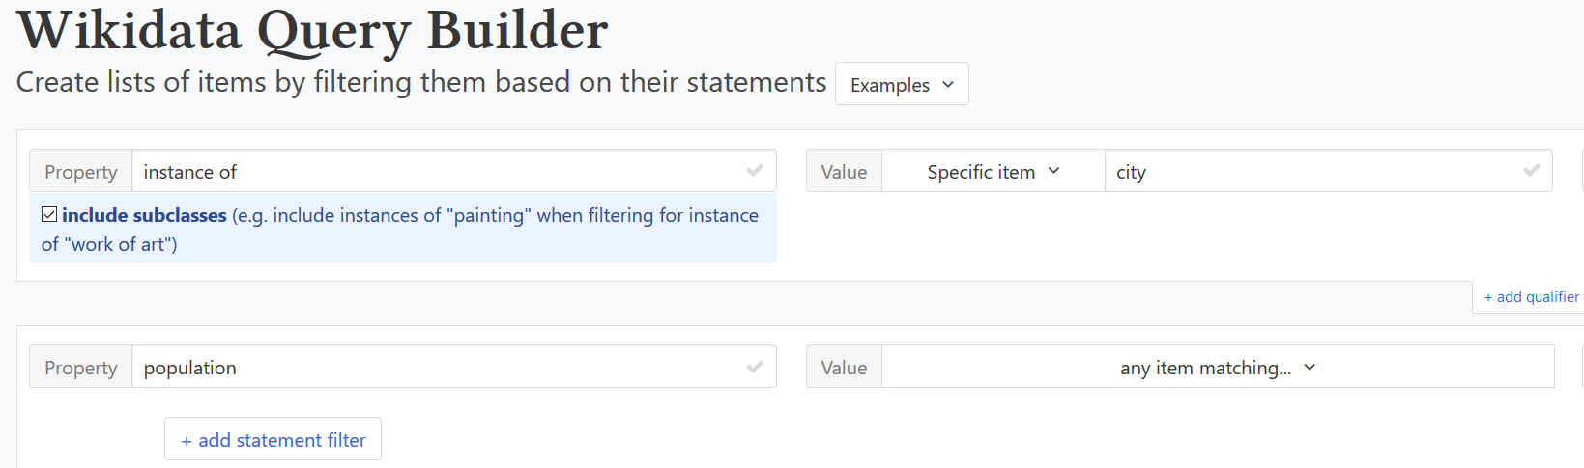
Wikidata Tools: Query Builders (Highlights)
Query builders help autocomplete and offer guidance when doing your queries

Slide 9
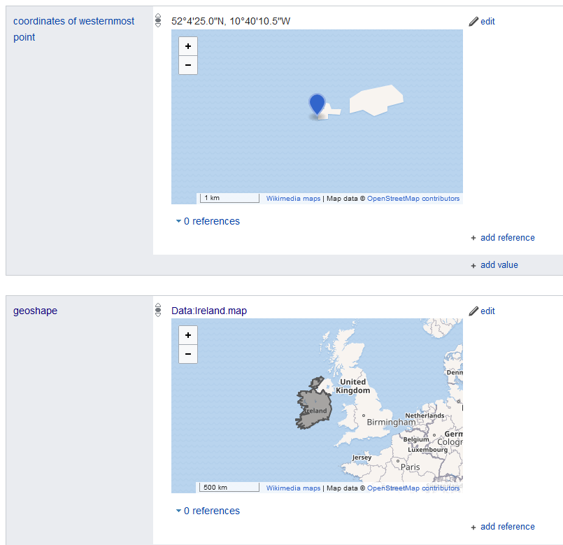
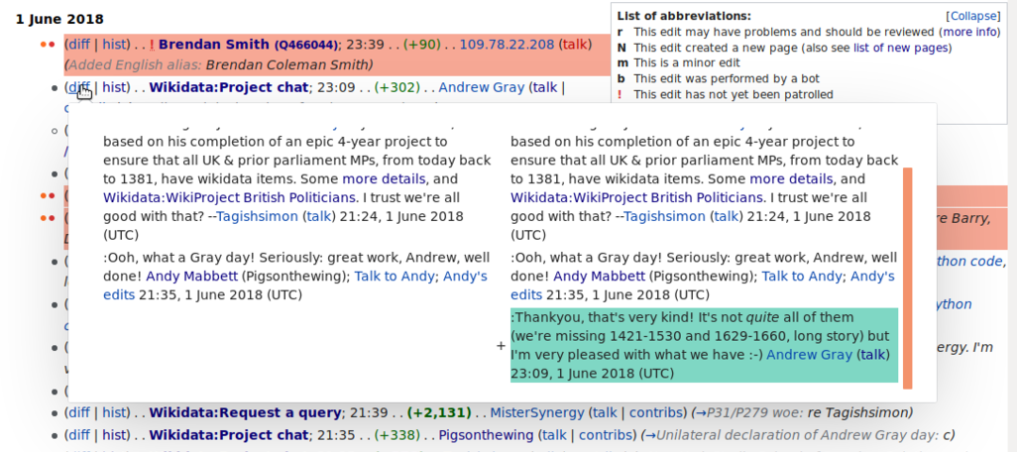
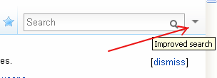
Wikidata Tools: Improve User Interface (Highlights)
CheckShex (validate entity against a Shex schema)
Navigation (request deleting, show more languages...)
Review differences in changes
Point/Geoschape statements
Improved search

Slide 10
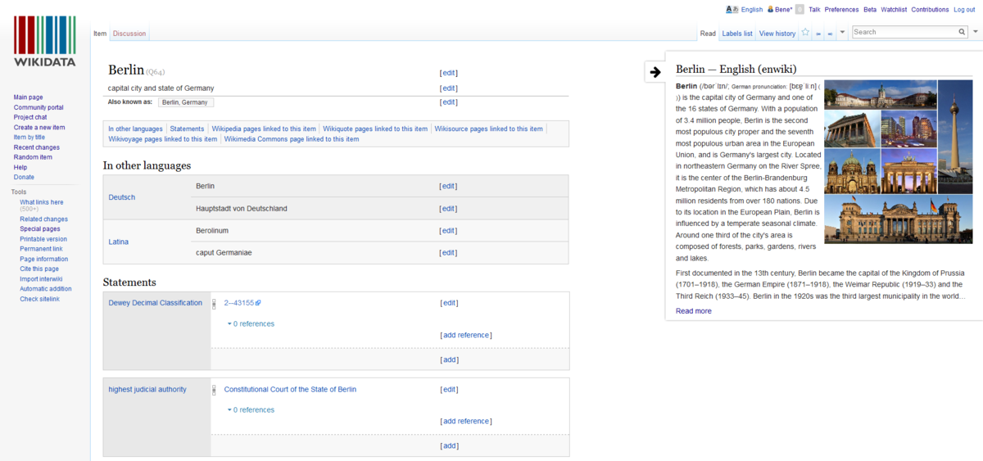
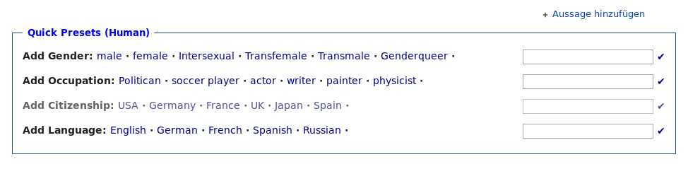
Wikidata Tools: Improve User Interface (Highlights)
Preview entries
Prepare template entries

Slide 11
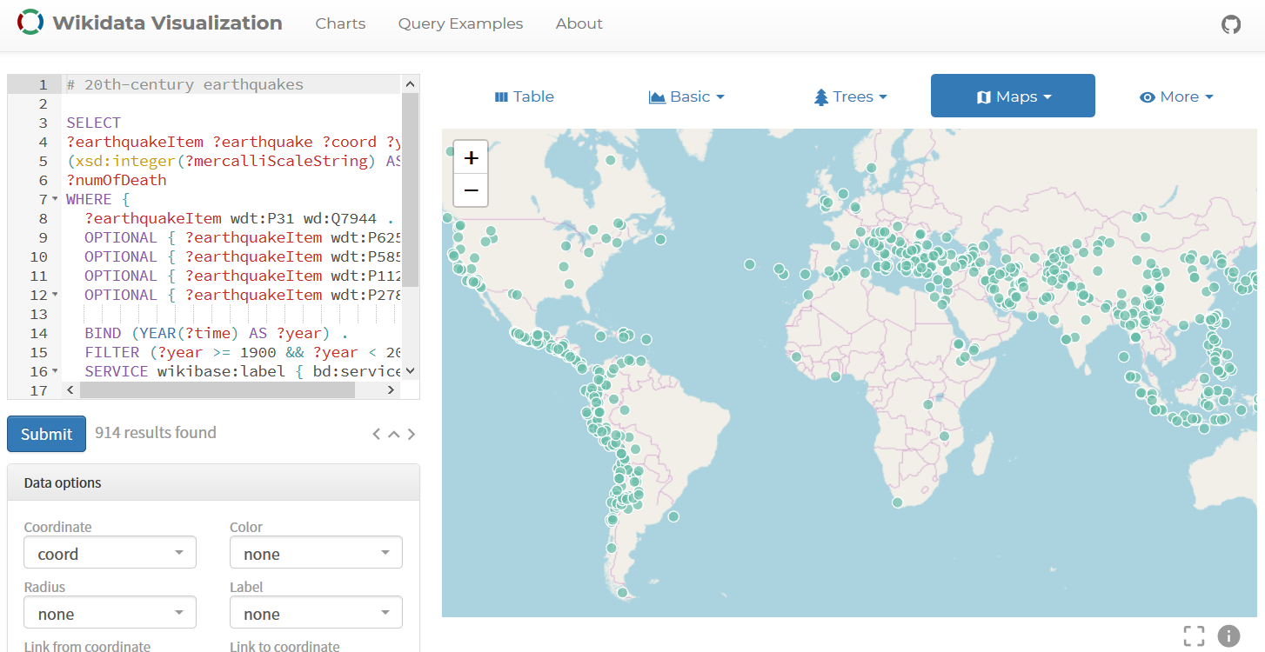
Wikidata Tools: Visualize Data (Highlights)
Query result visualization

Slide 12
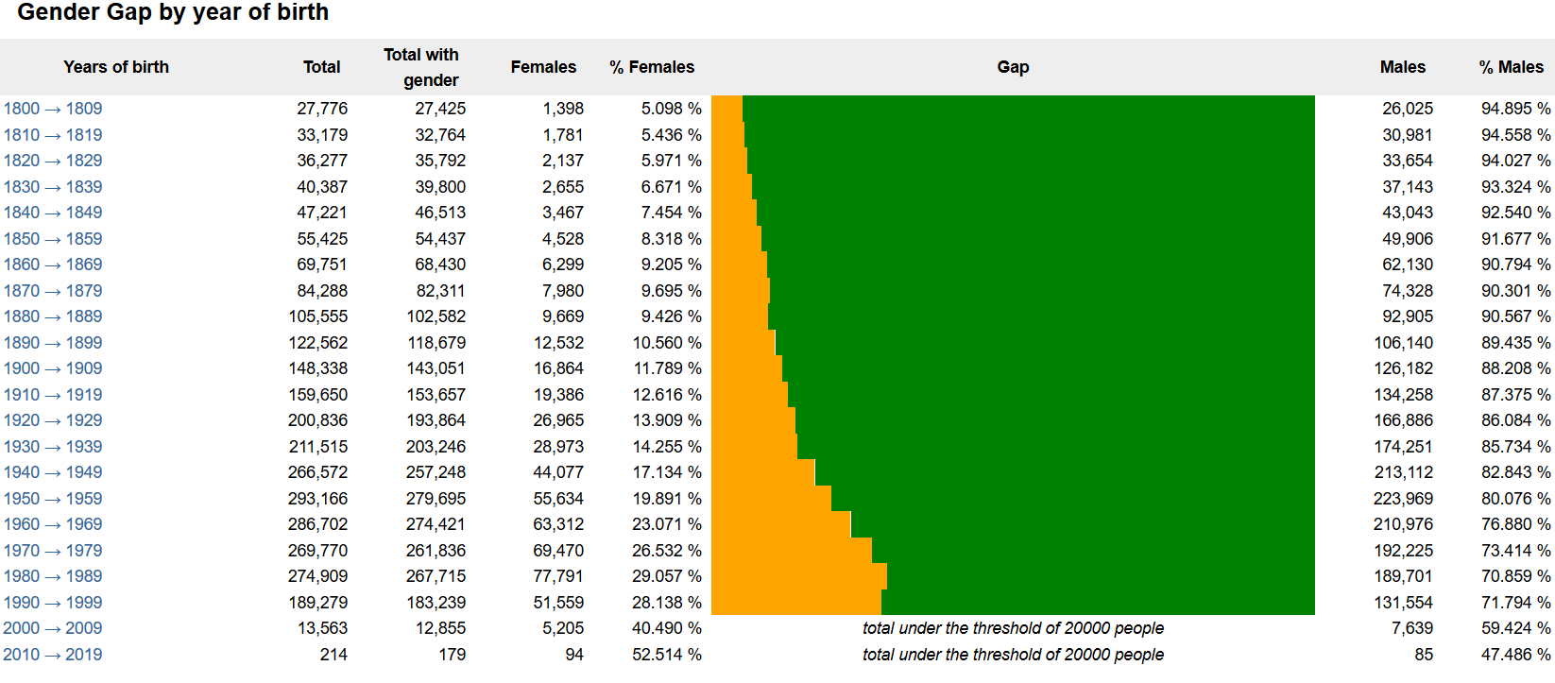
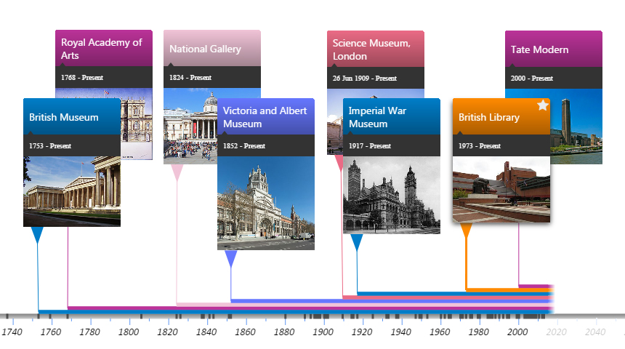
Wikidata Tools: Visualize Data (Highlights)
Gender gap analysis tools
Timeline analysis

Slide 13
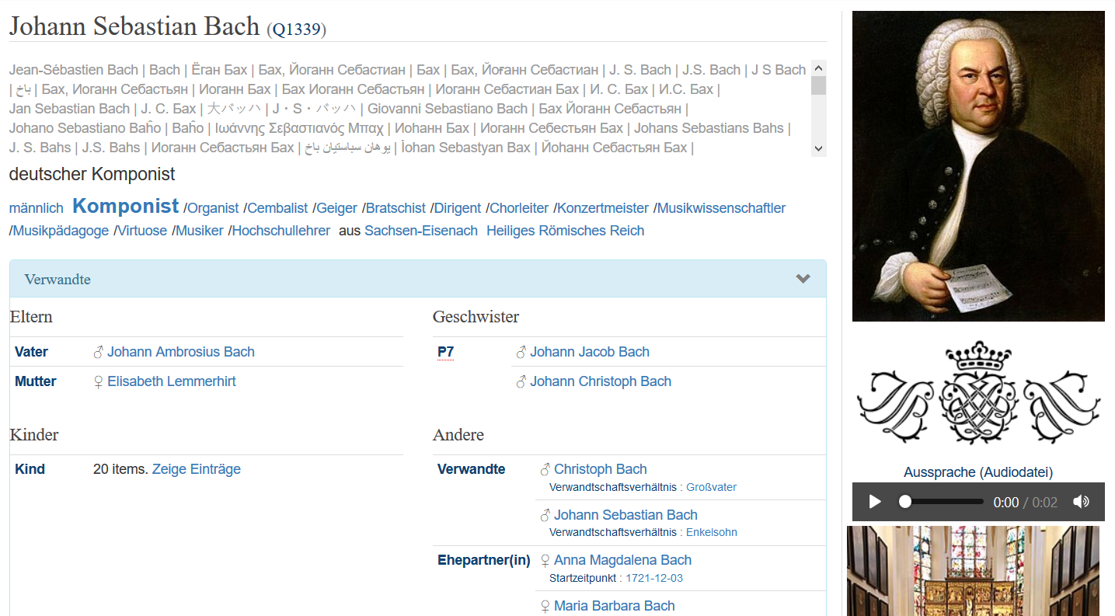
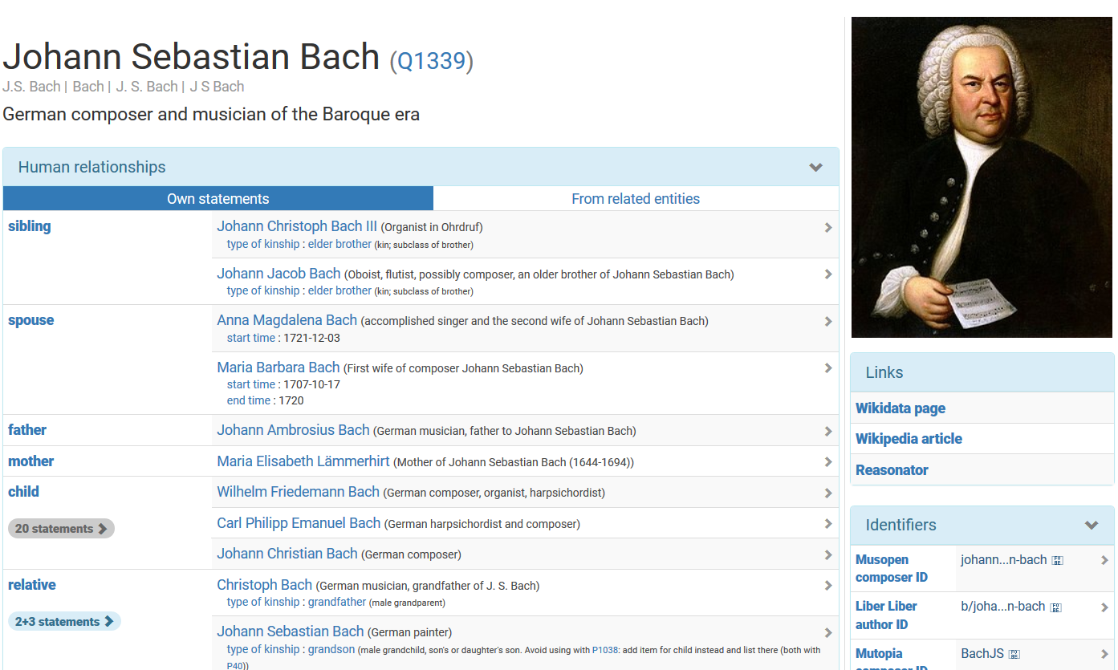

Wikidata Tools: Entity Browsing
Reasonator

Slide 14
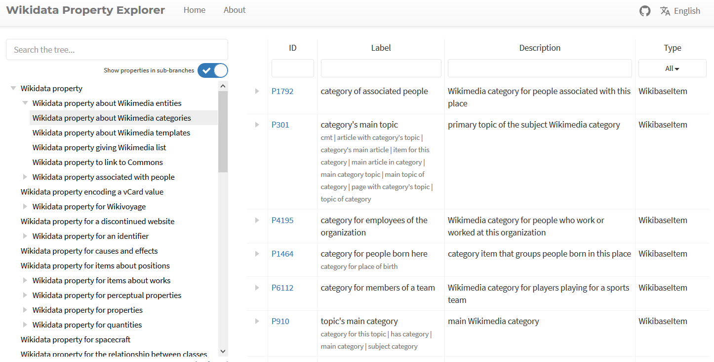
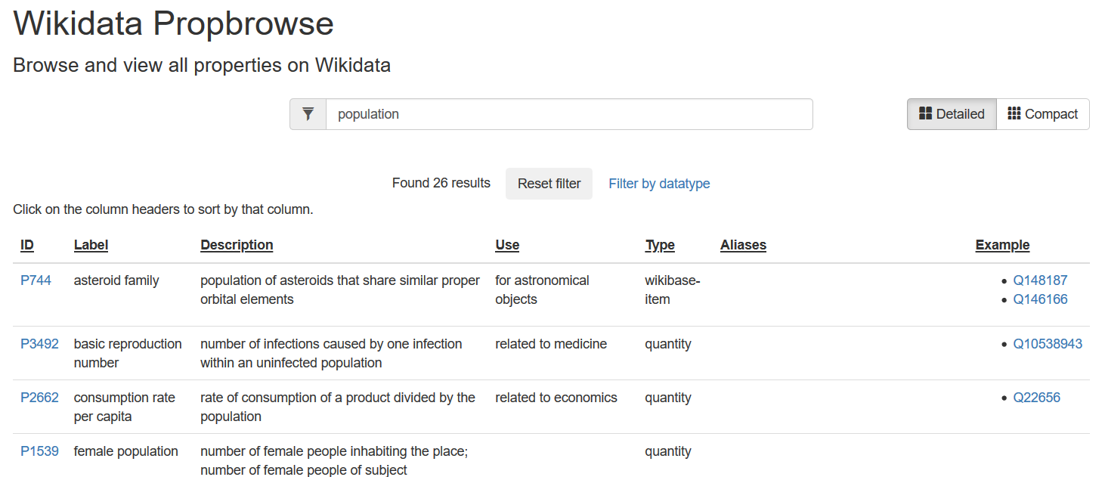
Wikidata Tools: Working with the Schema (Highlights)
From the taxonomy
From keyword search

Slide 15
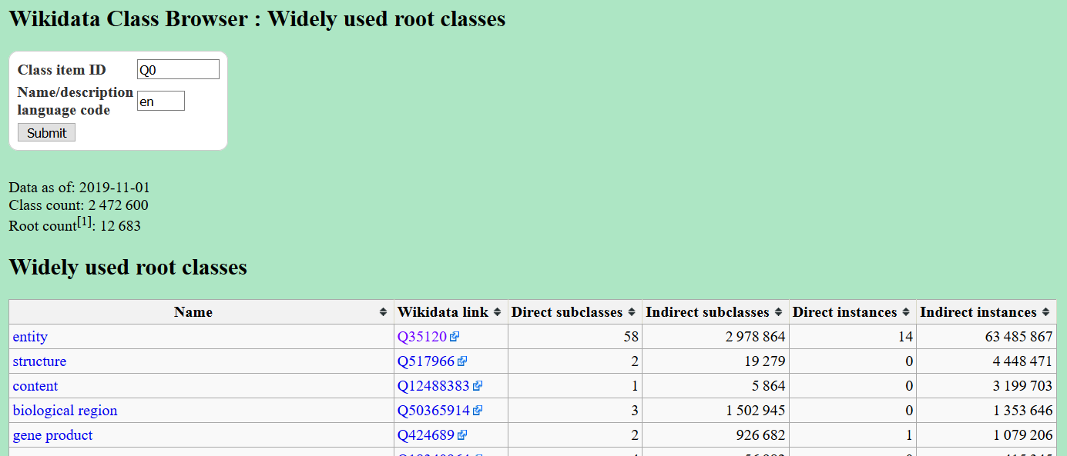
Wikidata Tools: Working with the Schema (Classes)
Commonly used classes
Entity browsers (SQID, Reasonator) can also be used to browse classes

Slide 16
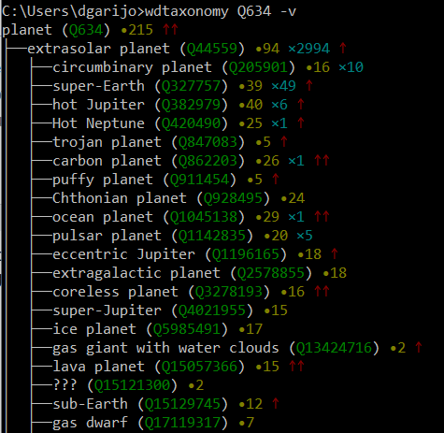
Wikidata Tools: Working with the Schema (Classes)
Command line tools such as wdtaxonomy or wdq are the best option
Very easy to navigate over properties, equivalent classes...

Slide 17
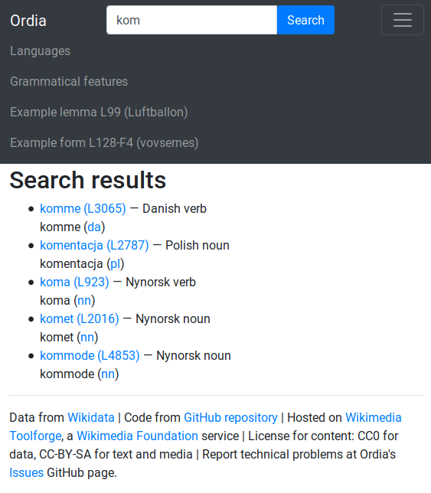
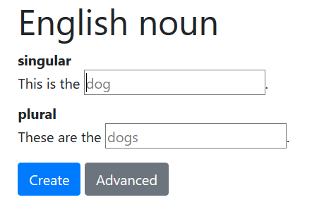
Wikidata Tools: Lexicographic Tools (Highlights)
Add lexeme or define a sense to an existing one
Search for existing lexemes

Slide 18
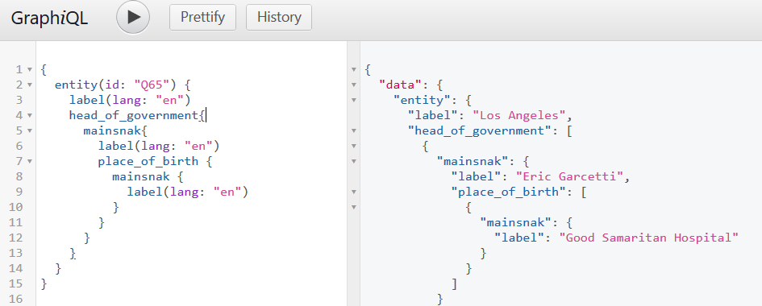
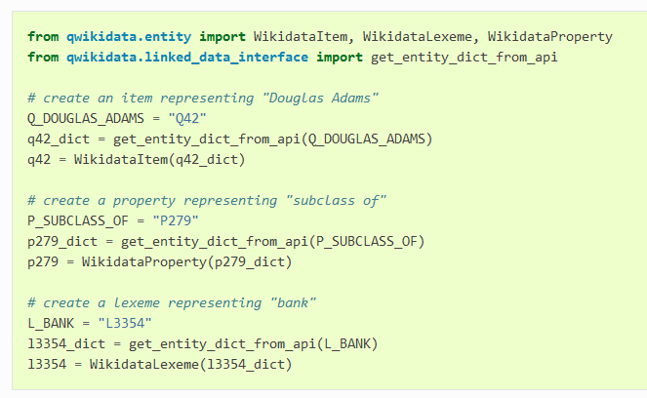
Wikidata Tools: Programmer Tools (Highlights)
GraphQL support
Qwikidata python package
(among many others)

Slide 19
Connecting Wikidata and Wikipedia Infoboxes

Slide 20
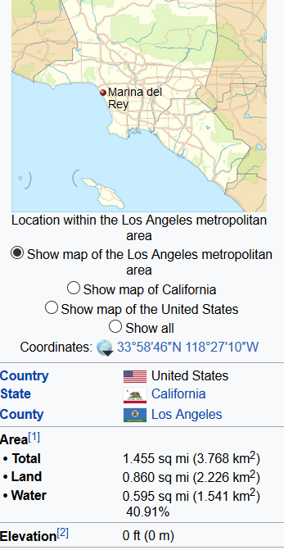
Wikipedia/Wikidata Infobox Overview
Infoboxes: short human –readable summaries of the information about an entity
Tabular format
Include images
Source for Semantic Web efforts such as DBPedia

Slide 21
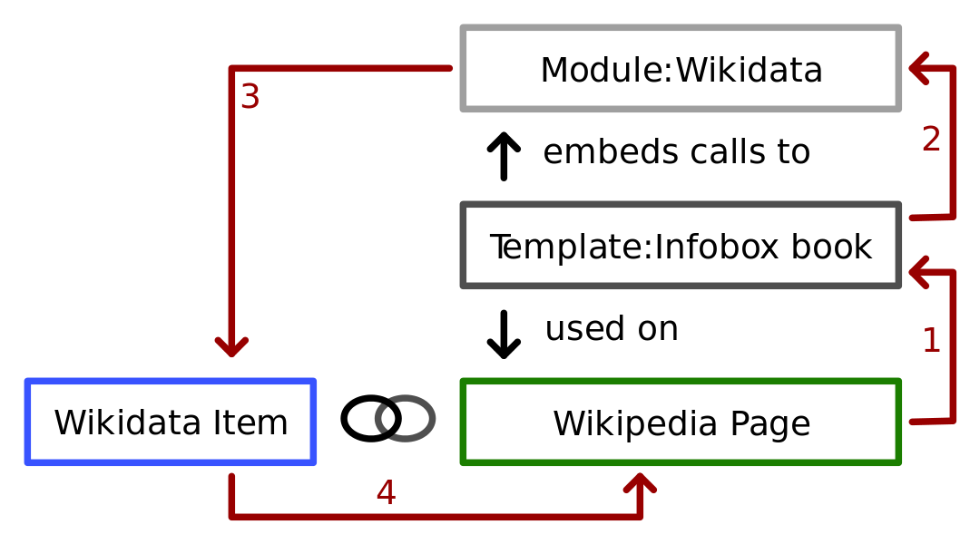
Wikipedia/Wikidata Infobox Connection

Slide 22

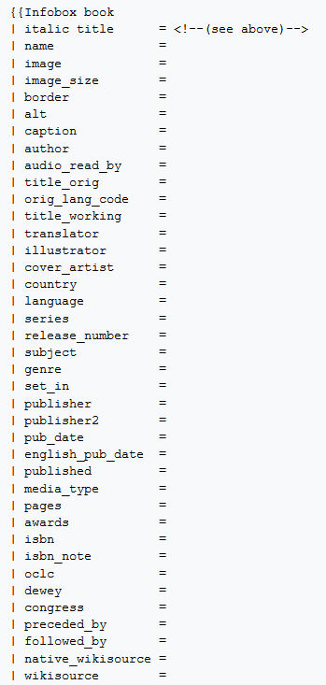
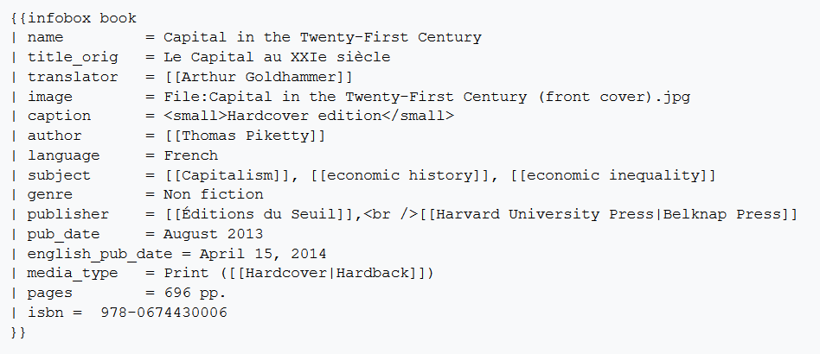
Wikipedia Template Modules
Before Wikidata

Slide 23
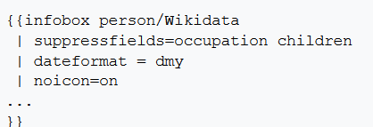
Wikidata Template Modules
Done!
You can customize how you import/show Wikidata terms:
Do not show “occupation” or “children”
Custom “edit on Wikidata” links
Example: https://en.wikipedia.org/wiki/Template:Infobox_person/Wikidata

Slide 24
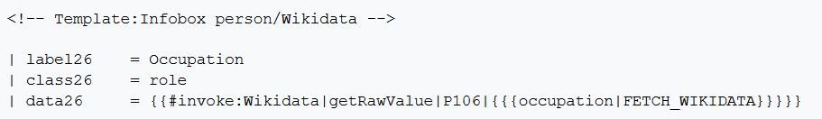
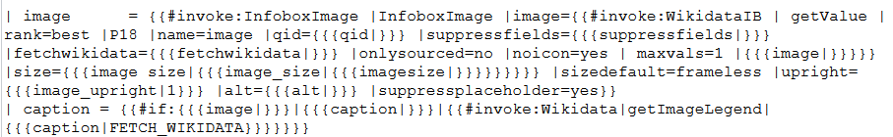
How does it work? Mapping to Wikidata
Wikidata on demand:
What if there are several values for the resource?

